Slide 1
Introduction to Wireless Communication
Microwave, Infrared & Bluetooth Communication

Slide 2
Microwaves
microwaves - electromagnetic waves with a frequency between 1GHz (wavelength 30cm) and 12GHz (wavelength 1mm)
microwaves frequency are further categorized into frequency bands: L (1-2 GHz), S (2-4 GHz), C (4-8 GHz), X (8-12 GHz)
receivers need an unobstructed view of the sender to successfully receive microwaves
microwaves are ideal when large areas need to be covered and there are no obstacles in the path

Slide 3
Advantages of microwaves over radio waves
because of high frequency, more data can be sent through microwaves -> increased bandwidth, higher speeds
because of their short wave length, microwaves use smaller antennas
smaller antennas produce a more focused beam which is difficult to intercept

Slide 4
Disadvantages of microwave communication
they require no obstacle is present in the transmission path
the cost of implementing the communication infrastructure is high
microwaves are susceptible to rain, snow, electromagnetic interference

Slide 5
Microwaves usages
carrier waves in satellite communications
cellular communication
bluetooth
wimax
wireless local area network
wireless sensors networks
GPS (Global Positioning System)

Slide 6
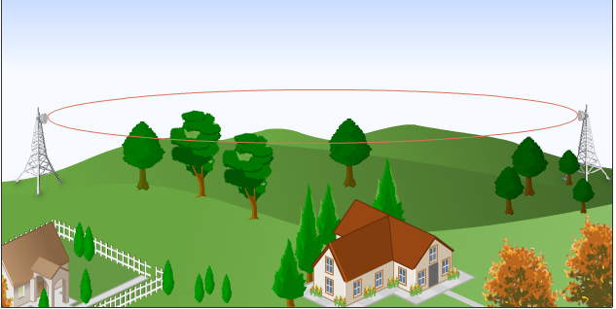
Microwave communication concepts
microwaves are generated by magnetrons through vibration of electrons
LoS (Line of Sight) – is a visible straight line between the sender and the receiver
LoS propagation – propagation of microwaves in a straight line free from any obstructions
Fresnel zone – eliptical area around the LoS between a sender and receiver; microwaves spread into this area once are generated by an antenna; this area should be free of any obstacles:

Slide 7
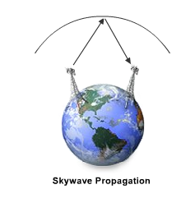
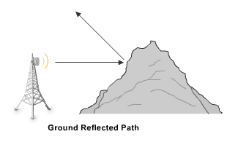
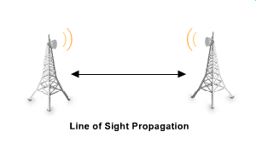
Microwave propagation modes
microwaves, one generated, propagate in a straight line in all directions
there are 3 modes of propagation possible, and the mode is decided based on distance and terrain:

Slide 8
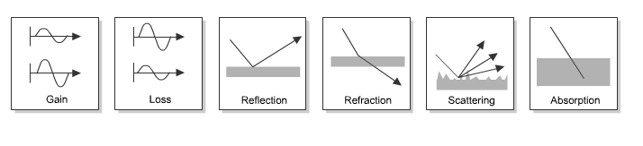
Microwave signal attenuation
- microwaves are absorbed by moisture or gases in the atmosphere

Slide 9

What would Wi-Fi microwaves would look like (if we could see them)
Wi-fi waves by Nickolay Lamm

Slide 10

What would Wi-Fi microwaves would look like (if we could see them)
Wi-fi waves by Nickolay Lamm

Slide 11

What would Wi-Fi microwaves would look like (if we could see them)
Wi-fi pulses
by Nickolay Lamm

Slide 12
Infrared & Bluetooth communication
are used in Wireless Personal Area Networks, a small area wireless network, spanning a range around 10m, involving computers/laptops, PDAs, cellular phones

Slide 13
Infrared waves
have frequency between 300 GHz and 400 THz and wave lengths between 1 mm and 750 nm
are classified into sub bands:
  near-infrared (120THz-400THz): are visible to the human eye as red and violet
  mid-infrared (30THz-120THz)
  far-infrared (300GHz-30THz): are not visible to the human eye, but are radiated in the form of heat
electromagnetic waves which are pulses of infrared light
are used for short range communication, unobstructed (e.g. remote control for a TV set), though they can reflect on hard surfaces
factors affecting communication: bright sunlight, hard obstacles (e.g. walls, doors), smoke, dust, fog

Slide 14
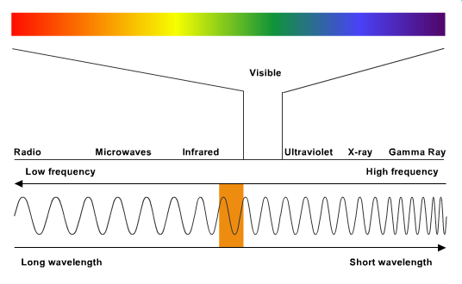
Wireless infrared communication = Wireless optical communication

Slide 15
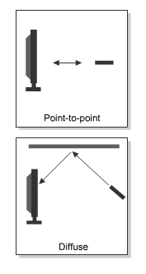
Infrared configuration
there are 2 infrared system configurations:
  point-to-point communication : transmitter and receiver are placed in the LoS, directed toward each other, free of obstacles; directed LoS systems
  diffuse communication: transmitter and receiver are placed in the vicinity, but not necessary in a straight line; non-directed non-LoS systems

Slide 16
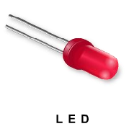
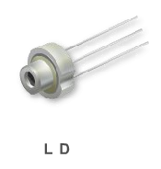
Infrared devices
LED (Light Emitting Diode)
  wider transmission beam
  suitable for diffuse configuration
  more widely used
LD (Laser Diode)
  have more focused beam
  are more efficient
many infrared devices (e.g. remote control, laptop, pda) follows the rules from IrDA (InfRared Data Association)

Slide 17
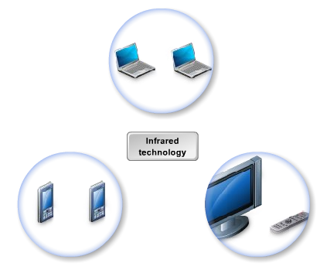
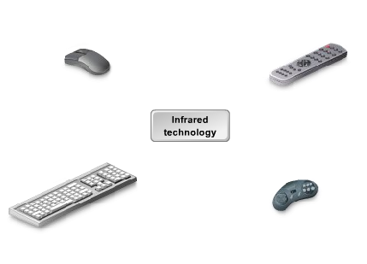
Infrared communicating devices

Slide 18
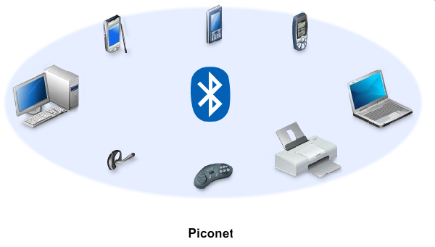
Bluetooth

Slide 19
Bluetooth (2)
short range communication (10m) between various devices like laptops, PDAs, PCs, gaming consoles etc.
works with higher distances (100m) in newer versions (Bluetooth 5.2, 2019)
creates a WPAN (Wireless Personal Area Network)
data and voice is exchanged at 2.4 GHz
max 8 devices can be connected to each other (piconet)
bluetooth devices operate at low power levels (1miliWatt)
“Bluetooth” technology was named in the memory of Danish king Harald Bluetooth

Slide 20
Bluetooth communication (1)
Uses frequency hopping spread spectrum for multiple access (i.e. multiple slaves) to transmit data on one of the 79 Bluetooth channels; 1600 hops per second
Each Bluetooth channel is 1MHz wide with a 1MHz separation between channels
uses GFSK (Gaussian Frequency-Shift Keying) modulation to encapsulate data in the carrier wave

Slide 21
Bluetooth communication (2)
Bluetooth communication protocol is packet based and has a master-slave architecture
Each slave can transmit to the master in a round-robin fashion
The master clock ticks with a period of 312.5 μs, two clock ticks then make up a slot of 625 µs
A packet can take 1 or more slots
The master begins transmission in even slots and begins reception in odd slots; the slave does the opposite

Slide 22
Bluetooth security
is wireless, so susceptible to interception
Bluetooth offers authentication and authorization
Bluetooth offers non-discoverable mode
Encrypts communication using algorithms based on the SAFER+ chiper
The Bluetooth key is derived from a Bluetooth PIN shared by both devices
Two pairing modes: legacy (simple 4 digit PIN) and SSP (Secure Simple Pairing; based on public key cryptography)

Slide 23
Bluetooth devices
laptops
personal computers
printers
PDA
GPS receivers
cellular phones
gaming consoles
head phones

Slide 24
Bluetooth vs Wi-Fi
Bluetooth offers speeds of up to 2Mbps, Wi-Fi much more
Bluetooth offers symmetrical communication (master-slave pair), Wi-Fi offers star like communication
Bluetooth is for simple, portable, equipment; Wi-Fi is for more complex devices as a replacement for wired Ethernet

